Slide 1
We have secured £180,000 of NCIL funding to refurbish Windmill playground.
The aims of the project are:
Add new drainage to eliminate flooding at the entrance.
Install new fencing and gates
Add a pathway inside the perimeter of the fencing to maximise the playable space
Reduce the mound and remove the log edging
Install a new ramp to the building for easy access.
Add natural play features such as wooden climbing unit and a mud kitchen

Slide 2
What is natural play?
There is substantial evidence that children have a strong and deep-rooted sensitivity to the natural world. Natural play offers children the chance to engage with a range of natural elements like wood, shrubbery and planting, trees, grass, mud.

Slide 3
What are the benefits of nature play?
Playing in natural spaces offers possibilities for: control and mastery, construction of special spaces, manipulating loose parts, different ways of moving, risk-taking etc.
Childhood experiences of playing with nature also instil a sense of wonder, stimulating creativity, imagination and symbolic play

Slide 4
What will the play space be like?
What would you like to see in the playground?
Look at the next 6 slides and choose the type of equipment and activity you would like to have
Please remember this is a small space
It will be for 2 to 8 year old children
It is open to the public and to the nursery
It is on common land so may need planning permission

Slide 5
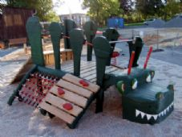
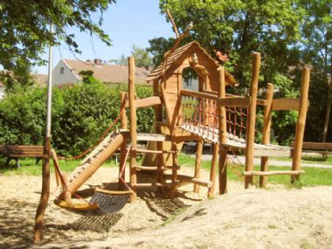
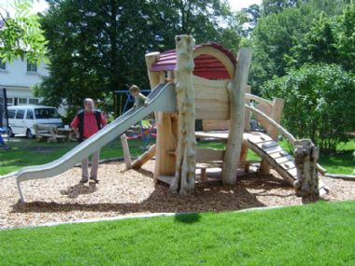
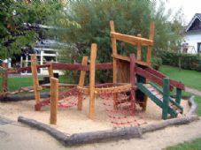
1. Multi-play climb and slide
Which style do you prefer?
A
B
C
D

Slide 6
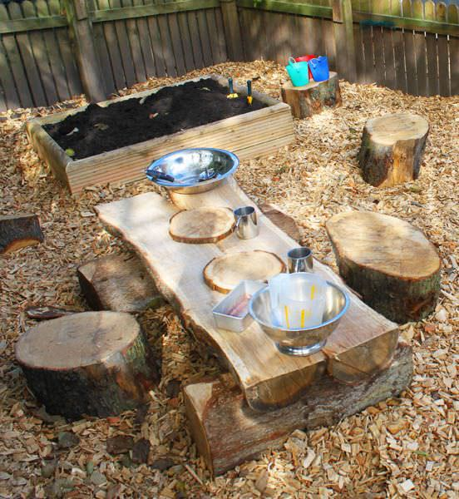
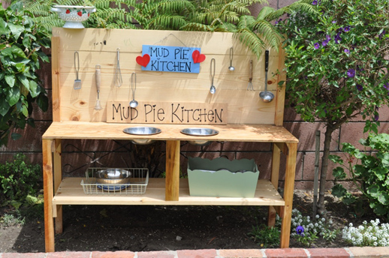
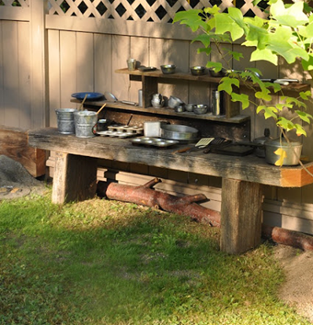
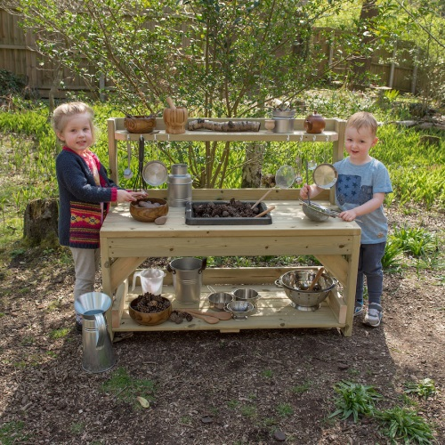
2. Mud kitchens
Which one is your favourite?
B
A
C
D

Slide 7
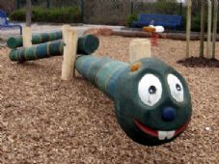
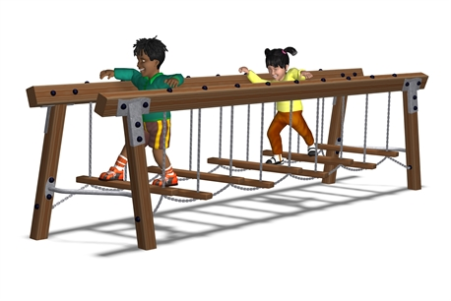
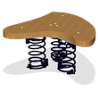
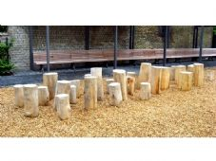
3. Balancing
Tell us which one is the best ?
A
B
C
D

Slide 8
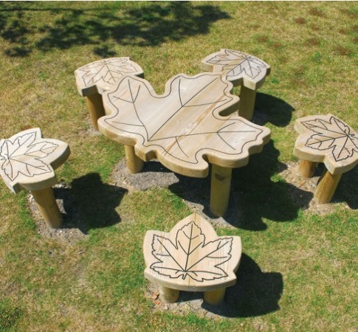
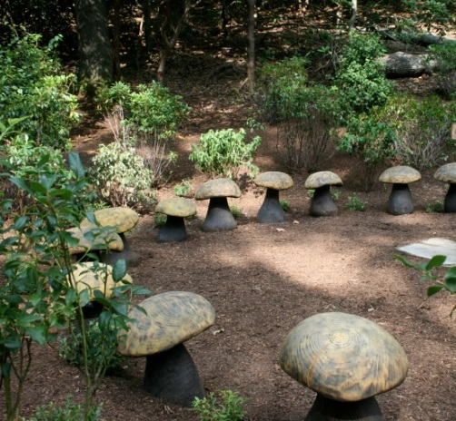
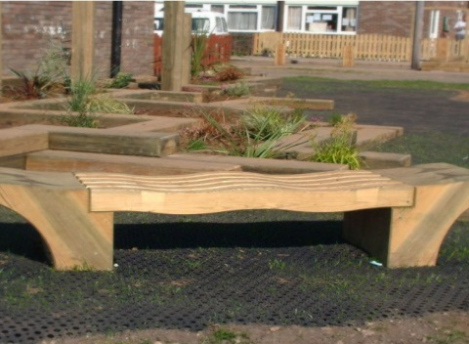
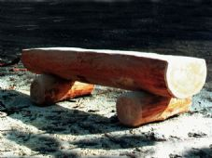
4. Seating
What type of seating do you like?
1
2
3
4

Slide 9
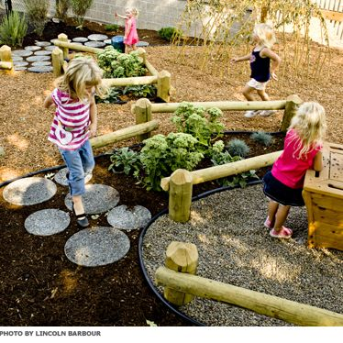
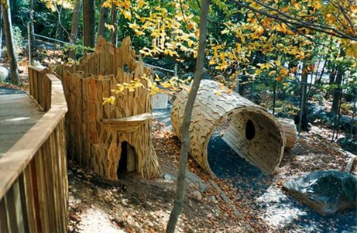
5. Paths
A
B
C
D

Slide 10
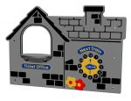

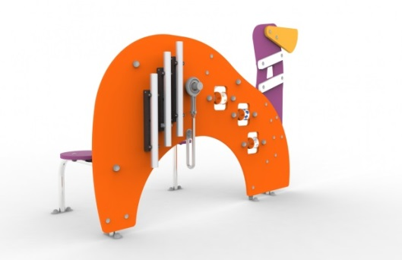
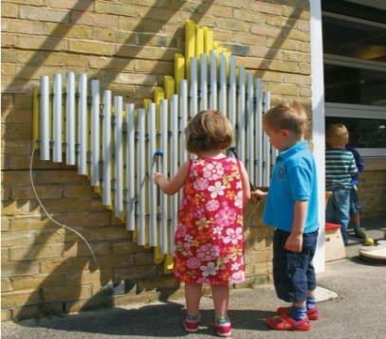
5. Activity panels
A
B
Imaginative play
Puzzles
C
D
Activity
Music

